Slide 1
SAS PROJECT – Retail Sales Analysis
Presentation by: Ali A. Nathani
Date: February 18, 2020

Slide 2
Presentation Outline
Background/Introduction
Objectives
Research Question(s)/Hypothesis(es)
Methodology/Inclusion/Exclusion/Definition
Conceptual Framework/Variables of the study
Descriptive Analysis :Uni/Bi/Multi variate Analysis
Results/findings
Conclusions
Recommendations
Appendix/Tables/Graph
SAS Scripts/Procedures/Graphs

Slide 3
Background / Introduction
Retail store customers’ transactional data were recorded from Apr,2007 to May,2008
to analyze various different products on Different dates, with 8 variables about the data in one Data Set and
to utilize some of the variables from the second Data Set with Electronic products with the category EC90, having 11 variables.
More information about the variables in both Data Sets, including no. of observations and the variables can be found in the table within Appendix by clicking the arrow below:
Data Set Info

Slide 4
Business Objectives
To find the variables/factors that had the most effect on quantity or sales during 2007 - 2008
To infer the probability of a location, City or Province to be among the most popular or average range of Quantity sold or average range of Sales
To infer the probability of a Source: Web, Regular, IVR, etc. to be among the most popular or average range of Quantity sold or average range of Sales

Slide 5
Research Questions / Hypothesis
1. What was the effect of the Variables on quantity or sales during 2007 - 2008?
Hypothesis
There was an association between Province and Quantity Sold
There was an association between Province and Sum of Sales
There was an association between City and Quantity Sold
There was an association between City and Sum of Sales
There was an association between Order Month, Source and Sum of Sales
There was an association between Order Year, Source and Sum of Sales

Slide 6
Methodology
Data cleansing/Validation
Data Preparation
Statistical Procedures
Descriptive Data Analysis
Using SAS 9.4

Slide 7
Methodology – Data cleansing / Validation
Remove the Duplicate records that were found
Exclude the 6 records that have a Quantity = 0 as it will not be needed in the analysis
Count missing values for all categories and remove unnecessary categories
Data Cleaning

Slide 8
Methodology – Data Preparation
Create the Sales Variable
Find the Customer_ID in the EC90 Data Set and
Include: the City, Prov & Postal Code for each customer in the first Data Set
Calculate Total Sales, Total Orders by Province and City, by Year, by Month for each Year
Data Cleaning

Slide 9
Methodology – Statistical Procedures
Use the Statistical Procedures that best describes the variables that have the most effect on the target, i.e. Sales or Quantity sold
Procedures – Sort, Frequency, Mean, Mode, Univariate
Inferential Statistics – Test using Chi-Square at a signifiance of 0.05

Slide 10
Conceptual Framework - 1
Independent Variables
Dependent Variables
Province
Total_Orders_Per_Customer
City
Total
Sales Amount

Slide 11
Conceptual Framework - 2
Independent Variables
Dependent Variables
Order Month
Total
Sales Amount
Source
Order Year

Slide 12
Variables of Study -Definitions
Independent Variables: Province – Location of Purchase/Purchaser Province, also location of Delivery might be the same City – Same as above Order Month – Month in which purchase was made. Generated from Order Date Order Year – Year in which purchase was made. Generated from Order Date Source – Includes all channels: Web, Regular, IVR and some Other categories
Dependent Variables (Calculated) Total Quantity of Orders per Customer Total Sales Amount

Slide 13
Descriptive Data Analysis
Univariate Analysis –
Distribution of Quantity,
Distribution of Sales,
Frequency of Category
Bi-variate Analysis -
Total count of orders by Province,
Total sum of Sales by Province,
Total count of orders by City in highest performing Province
Total sum of Sales by Source and by Province
Total sum of Sales by Source and by City

Slide 14
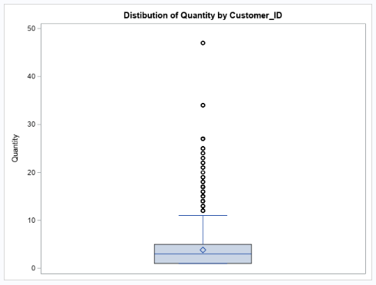
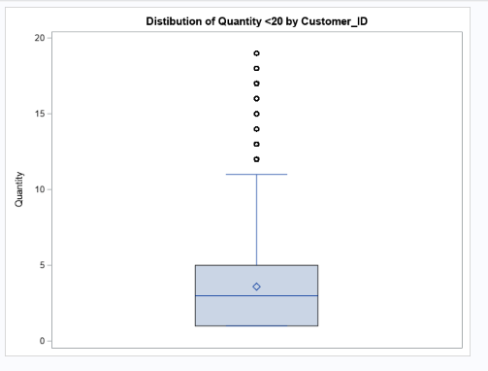
Univariate Descriptive Analysis
The above shows the spread of the Total Quantity purchased by each Customer.
The second graph has been scaled down to better understand the Range

Slide 15
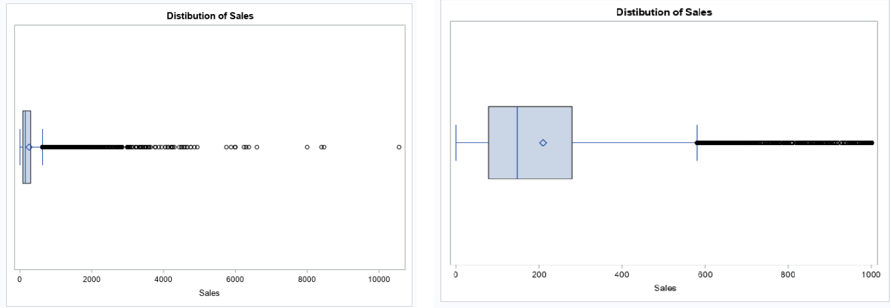
Univariate Descriptive Analysis
The above shows the spread of the Total Sales by each Customer.
The second graph has been scaled down to better understand the Range

Slide 16
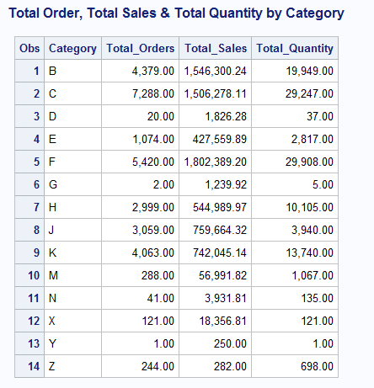
Additional Univariate Analysis

Slide 17
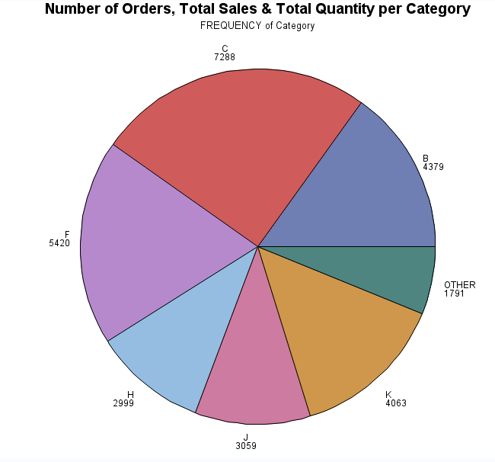
Univariate Descriptive Analysis

Slide 18
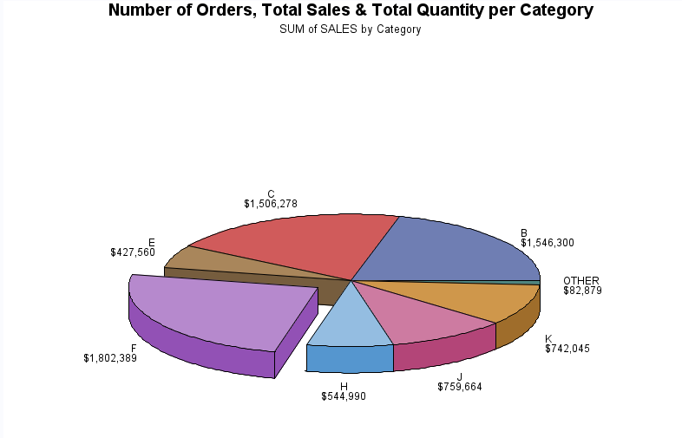
Univariate Descriptive Analysis

Slide 19
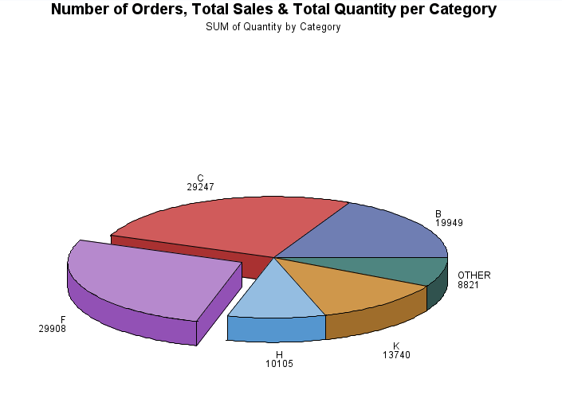
Univariate Descriptive Analysis

Slide 20
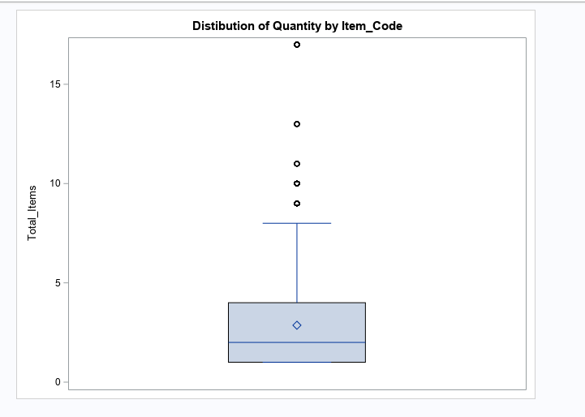
Univariate Analysis

Slide 21
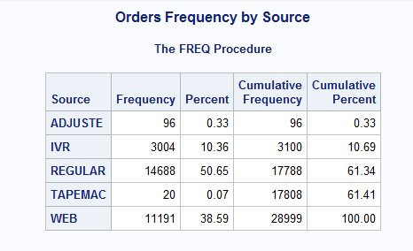
Univariate Analysis

Slide 22
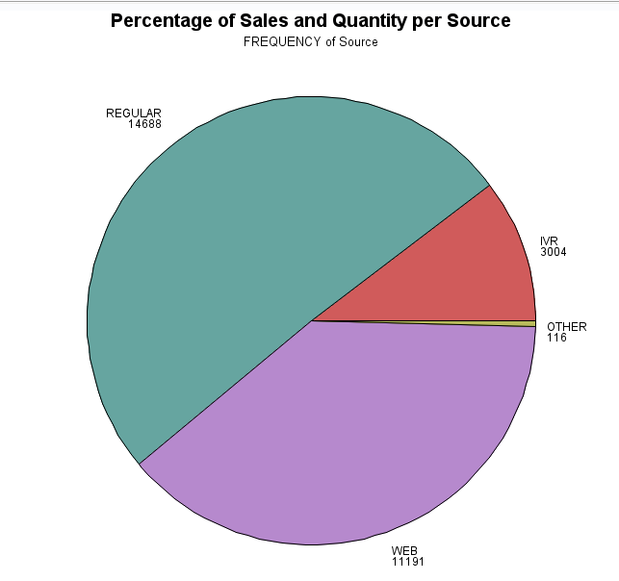
Univariate Analysis

Slide 23
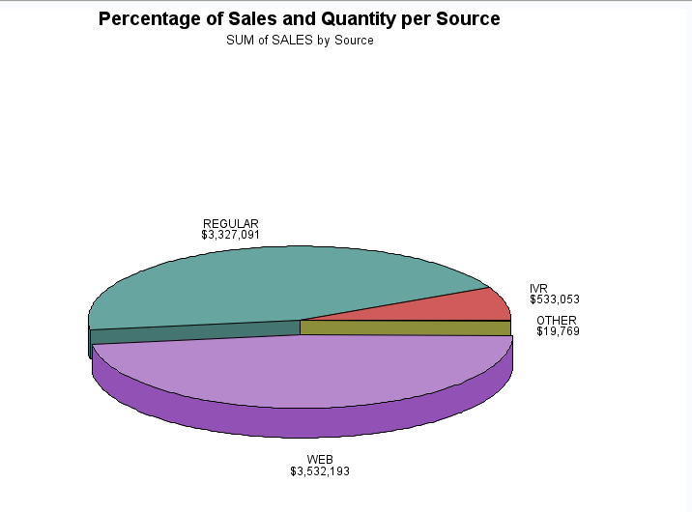
Univariate Analysis

Slide 24
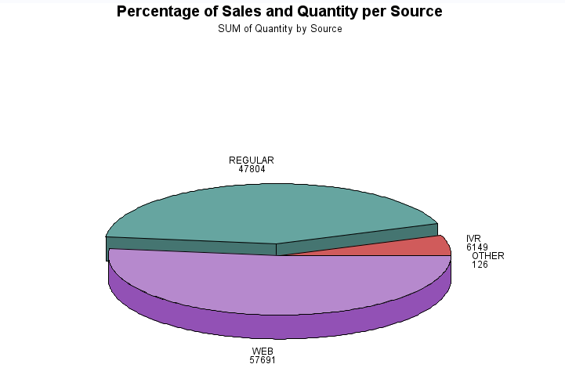
Univariate Analysis

Slide 25
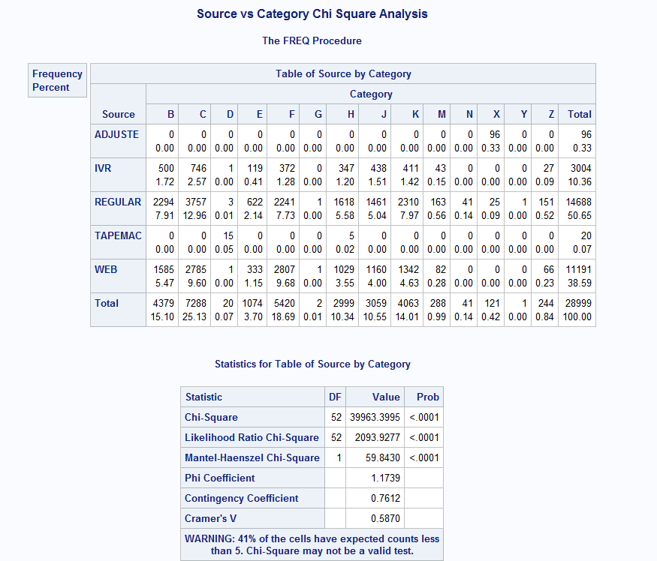
Bi-variate Analysis

Slide 26
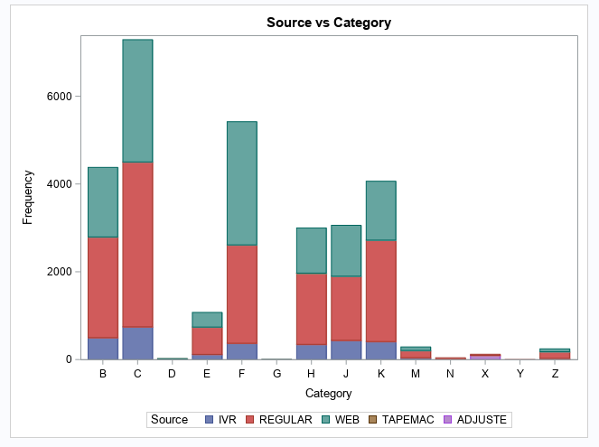
Bi-Variate Analysis

Slide 27
APPENDIX
Tables
Summary of Variables
Info on 2 Data Sets
Data Cleansing/Prep

Slide 28
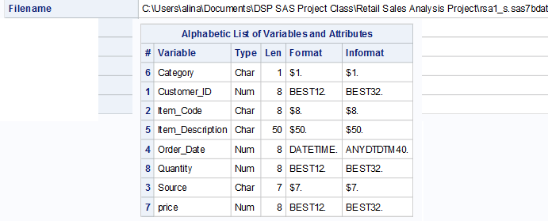
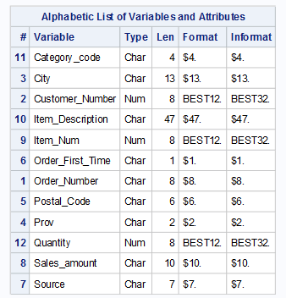
Tables: - Info on 2 Data Sets
Background Info
2 Data sets were recorded with the following:
DATA SET 1
DATA SET 2

Slide 29
Tables: - Info on 2 Data Sets
Background Info
2 Data sets were recorded with the following:
Info: | Data Set 1 | Data Set 2
No. Of Records | 34,288 | 1,297
Type of Products | Variety of different products | Electronics category EC90 only: Acer Aspire 16" Multimedia Notebook Computer
Demographics: Location Info: | No Location information | City, Province and Postal Code
Different Order Details | Order Date | Order_Number, Order_First_Time (Y/N)
Sales information | Price & Quantity | Sales_Amount & Quantity
Common | Customer_ID, Item_Code, Source, Item_Description, Category, Quantity | Customer_Number, Source, Item_Num, Item_Description, Category_code, Quantity

Slide 30
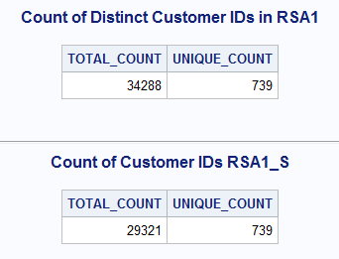
Tables- Data Cleansing/Prep
Methodlogy

Slide 31
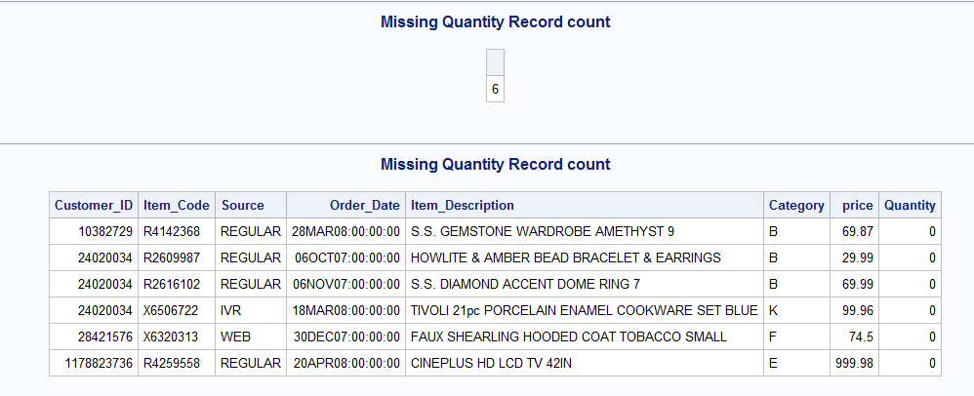
Tables- Data Cleansing/Prep
Methodlogy

Slide 32
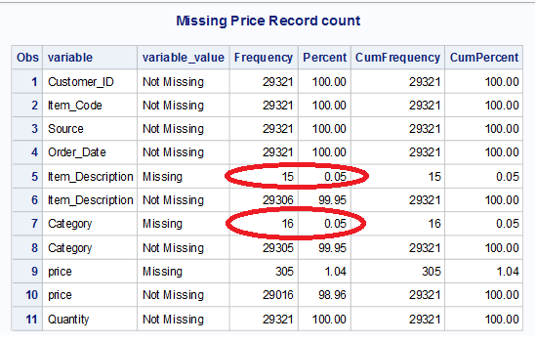
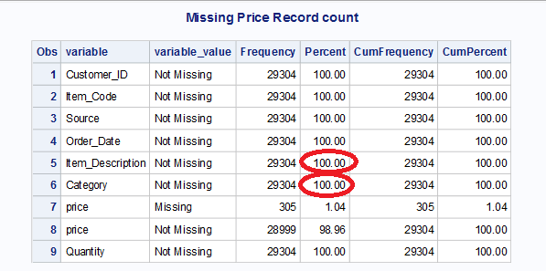
Tables- Data Cleansing/Prep
Methodlogy

Slide 33
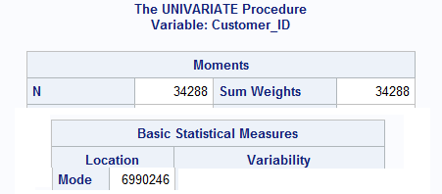
Customer with most frequency
Customer ID # 6990246 had the highest frequency in Data Set 1

Slide 34
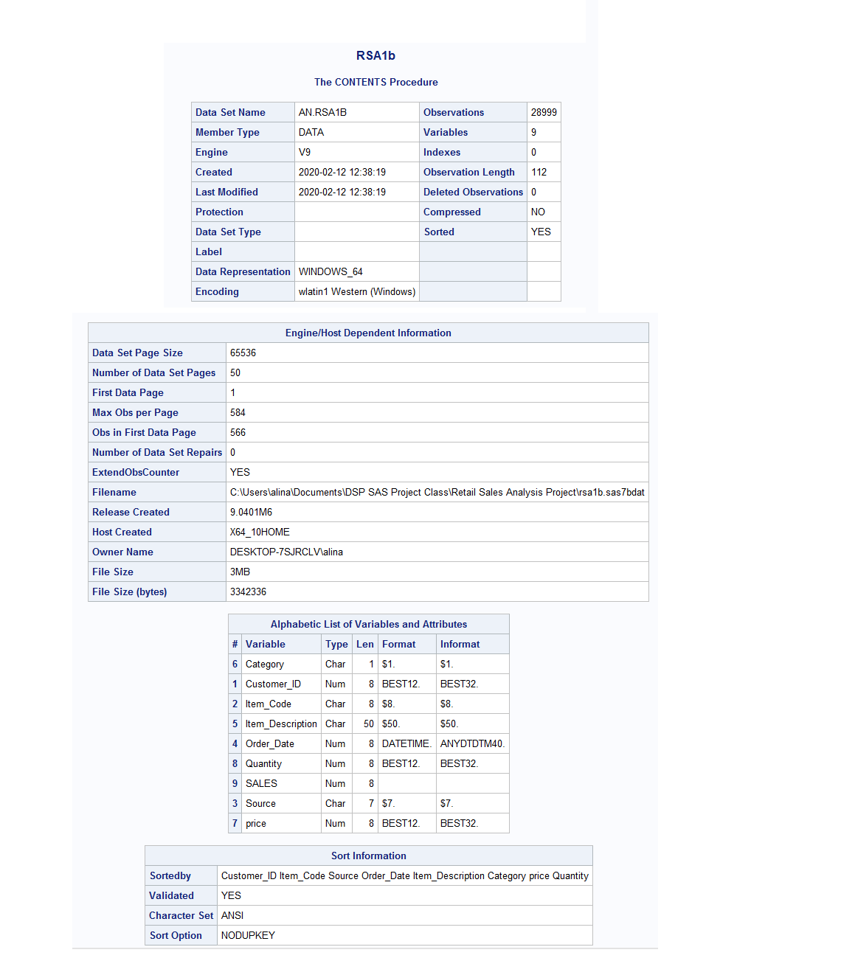
Summary of Variables

Slide 35
SAS SCRIPTS
libname AN "C:\Users\alina\Documents\DSP SAS Project Class\Retail Sales Analysis Project";
*import data to SAS;
PROC IMPORT OUT= AN.RSA1
DATAFILE= "C:\Users\alina\Documents\DSP SAS Project Class\Retail Sales Analysis Project\transactionhistoryforcurrentcustomers.csv"
DBMS=CSV REPLACE;
GETNAMES=YES;
DATAROW=2;
RUN;
*UNDERSTAND YOUR DATA AND ITS PROPERTIES;
TITLE "RSA1a";
PROC CONTENTS DATA = AN.RSA1;
RUN;
TITLE "RSA1a";
PROC UNIVARIATE DATA = AN.RSA1;
RUN;
*DATA VALUE;
PROC PRINT DATA = AN.RSA1 (OBS = 20);
TITLE "RSA1";
RUN;
*CHECK FOR MISSING VALUES;
PROC MEANS DATA = AN.RSA1 N NMISS;
RUN;
DATA AN.RSA1a;
set AN.RSA1;
if cmiss(of _all_) then delete;
run;
*CHECK FOR MISSING VALUES AGAIN;
PROC MEANS DATA = AN.RSA1a N NMISS;
TITLE 'RSA1a';
RUN;
*DUPLICATES;
*COUNT COLS;
TITLE "Count of Distinct Customer IDs in RSA1a";
PROC SQL;
SELECT COUNT(Customer_ID)AS TOTAL_COUNT, COUNT(DISTINCT Customer_ID) AS UNIQUE_COUNT
FROM AN.RSA1a
;
QUIT;

Slide 36
SAS SCRIPTS
*REMOVE DUPLICATE OBSERVATIONS and check count again;
PROC SORT DATA = AN.RSA1a OUT = AN.RSA1a_S dupout=AN.RSA1aDup NODUPKEY;
BY _ALL_;
RUN;
*COUNT AGAIN;
TITLE 'Count of Customer IDs RSA1_S';
PROC SQL;
SELECT COUNT(Customer_ID)AS TOTAL_COUNT, COUNT(DISTINCT Customer_ID) AS UNIQUE_COUNT
FROM AN.RSA1a_s
;
QUIT;
*FEATURE GENERATION FOR ;
*create sales columns in RSA1 ;
PROC SQL ;
CREATE TABLE AN.RSA1b AS
SELECT *, PRICE*QUANTITY AS SALES
FROM AN.RSA1a_s
;
QUIT;
TITLE 'RSA1b';
PROC CONTENTS data = AN.RSA1b; run;
TITLE 'RSA2b';
PROC CONTENTS data = AN.RSA2b; run;
*SELECT VARIABLES IDENTIFIED IN YOUR STUDY FRAMEWORK;
*Total Sales;
TITLE ' Total Sales for RSA1b';
PROC SQL;
SELECT sum(Sales)as TOTAL_Sales format=comma20.2
FROM AN.RSA1b
;
QUIT;

Slide 37
SAS SCRIPTS
*Sales by Item Code and by Category;
/*each group*/
/* 'Sales by Category';*/
PROC SQL;
CREATE TABLE AN.RSA1Category AS
SELECT Category, COUNT(Customer_ID) format=comma20.2 AS Total_Orders, sum(Sales) format=comma20.2 AS Total_Sales, sum(Quantity) format=comma20.2 AS Total_Quantity
FROM AN.RSA1b
GROUP BY Category
ORDER BY Category;
QUIT;
proc print data = AN.RSA1Category;
TITLE 'Total Order, Total Sales & Total Quantity by Category'; run;
TITLE "Number of Orders, Total Sales & Total Quantity per Category";
PROC GCHART DATA = AN.RSA1b;
format sales dollar20.;
PIE Category
;
RUN;
pie3d Category / sumvar=Sales
explode="F";
run;
pie3d Category / sumvar=Quantity
explode="F";
run;
quit;
/*title 'in Category C, which products have most orders';*/
PROC SQL;
CREATE TABLE AN.RSA1MostOrderItem AS
SELECT *, COUNT(Item_Code) AS Total_Items, sum(Sales) format=comma20.2 AS Total_Sales, sum(Quantity) format=comma20.2 AS Total_Quantity
FROM AN.RSA1b
Where Category = 'C'
GROUP BY Item_Code
ORDER BY Total_Items DESC
;
QUIT;
proc sgplot data = AN.RSA1MostOrderItem;
vbox Total_Items;
title 'Distibution of Quantity by Item_Code';
run;

Slide 38
SAS SCRIPTS
/*Distribution of orders & sales across Source*/
title "Orders Frequency by Source";
proc freq data =AN.RSA1b;
table Source;
run;
TITLE "Percentage of Sales and Quantity per Source";
PROC GCHART DATA = AN.RSA1b;
format sales dollar20.;
PIE Source
;
RUN;
pie3d Source / sumvar=Sales
explode="WEB";
run;
pie3d Source / sumvar=Quantity
explode="REGULAR";
run;
quit;
*BIVARIATE ANALYSIS
*chi square analysis;
PROC FREQ DATA = AN.RSA1b;
TITLE 'Source vs Category Chi Square Analysis';
TABLE Source* Category/CHISQ NOROW NOCOL ; *CAN KEEP PERCENT, DO NOT INCLUDE NOPERCENT OR USE NOFREQ FOR ONLY PERCENT;
RUN;
*STACKED BAR CHART;
PROC SGPLOT DATA = AN.RSA1b;
TITLE 'Source vs Category ';
VBAR CATEGORY/GROUP=SOURCE;
RUN;

